Slide 2
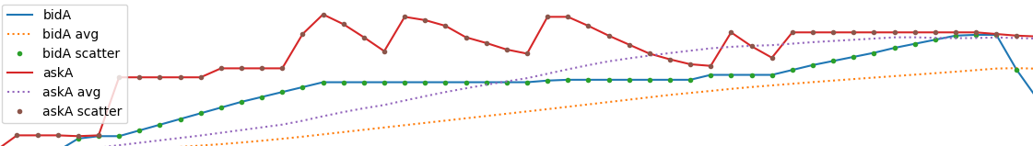
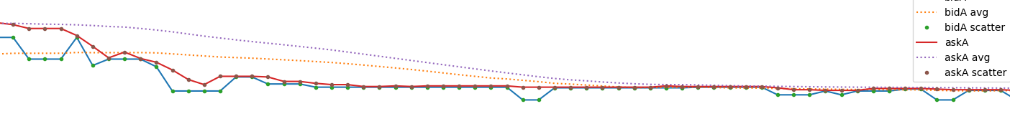
Market states
Ask is competitive in a recursive manner
Ask is stable while the bid rises
Bid is stable
Bid is rising
Bid fall
Indicating bulishness?
Bid is rising
Long assert exchange – zero spread zone

Slide 3
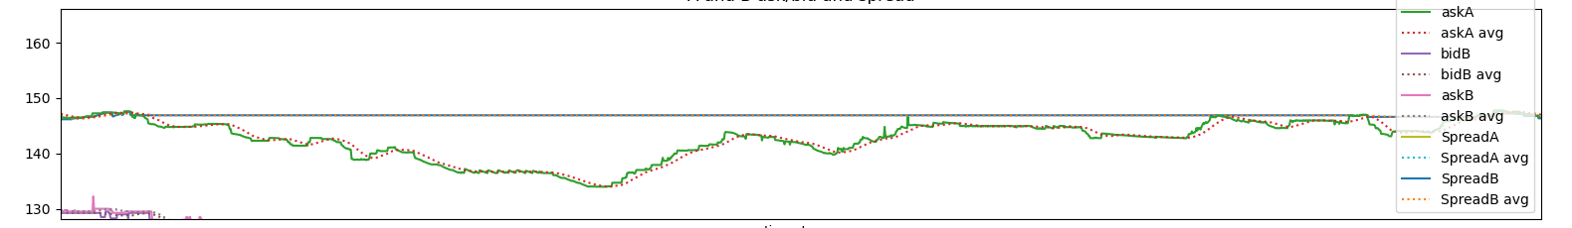
Market states
Long negative spread
Bid doesn’t correct itself

Slide 4
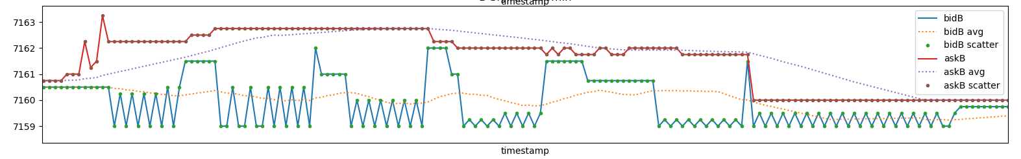
Market states
Somebody wants to buy?

Slide 5
Market maker strategy
Somebody wants to sell fast – close to the bid price
ask
bid
Somebody wants to buy fast – at ask price
The seller market maker provides the liquidity
Market maker detects the
demand and provides the liquidity

Slide 6
Market maker strategy – provide liquidity
Earnings = N/2 * operation gain
OG = Spread * (1-2*MMmargin)
Spread = 2%
Mmmargin – margin of trade – a part of the spread = 10%
OG = 0.02 * (1-2*0.1) = 0.02*0.8=0.016
Earnings = 6/2*0.016 = 0.048
ask
bid
Buy -> sell -> buy -> sell -> buy -> sell ->buy

Slide 7
Model config

Slide 8
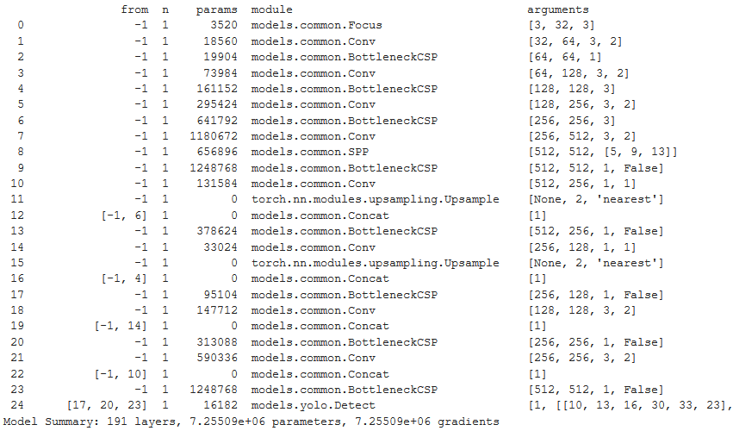

Slide 9
Prepare data with roboflow

Slide 10
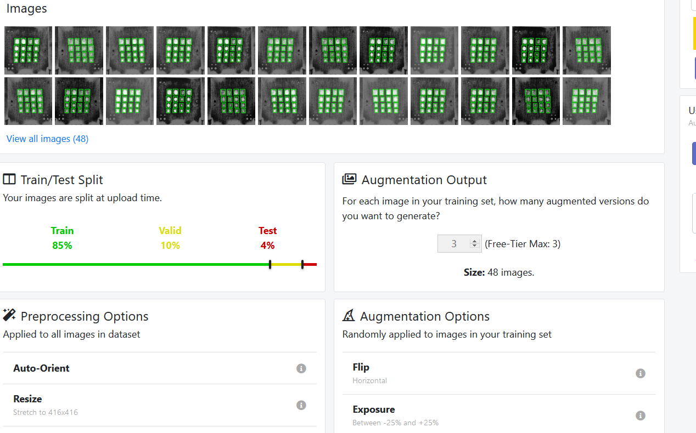

Slide 11
Training

Slide 12
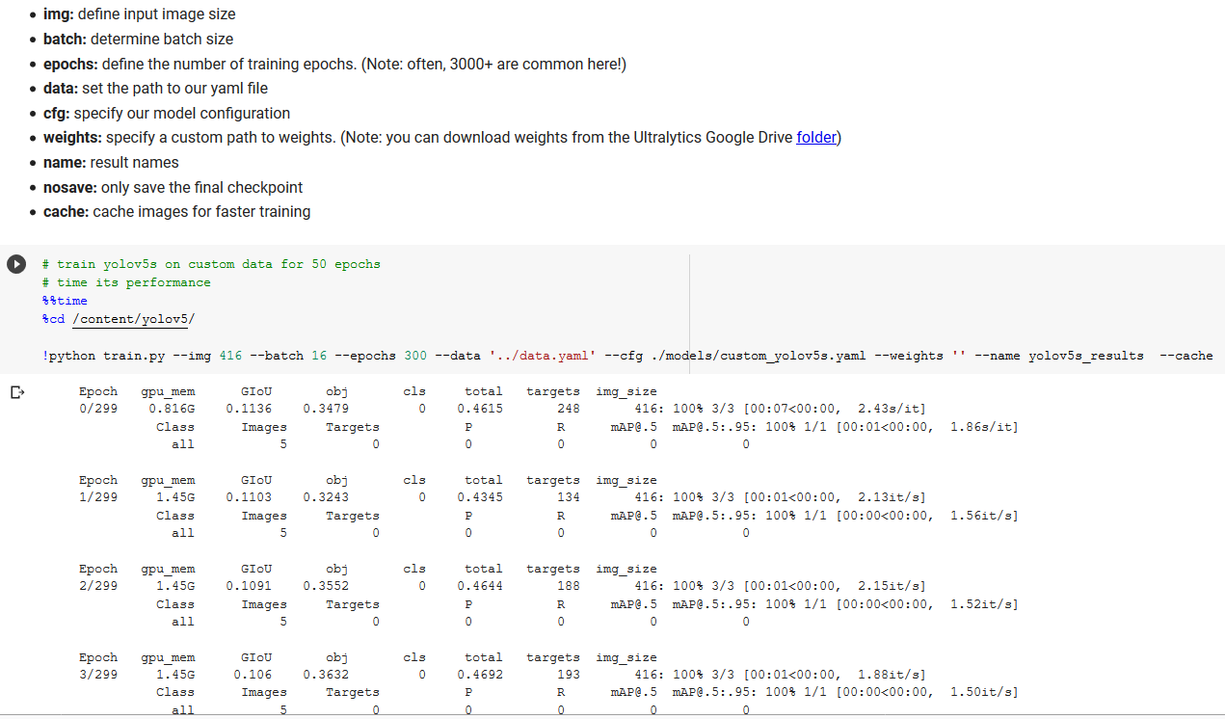

Slide 13
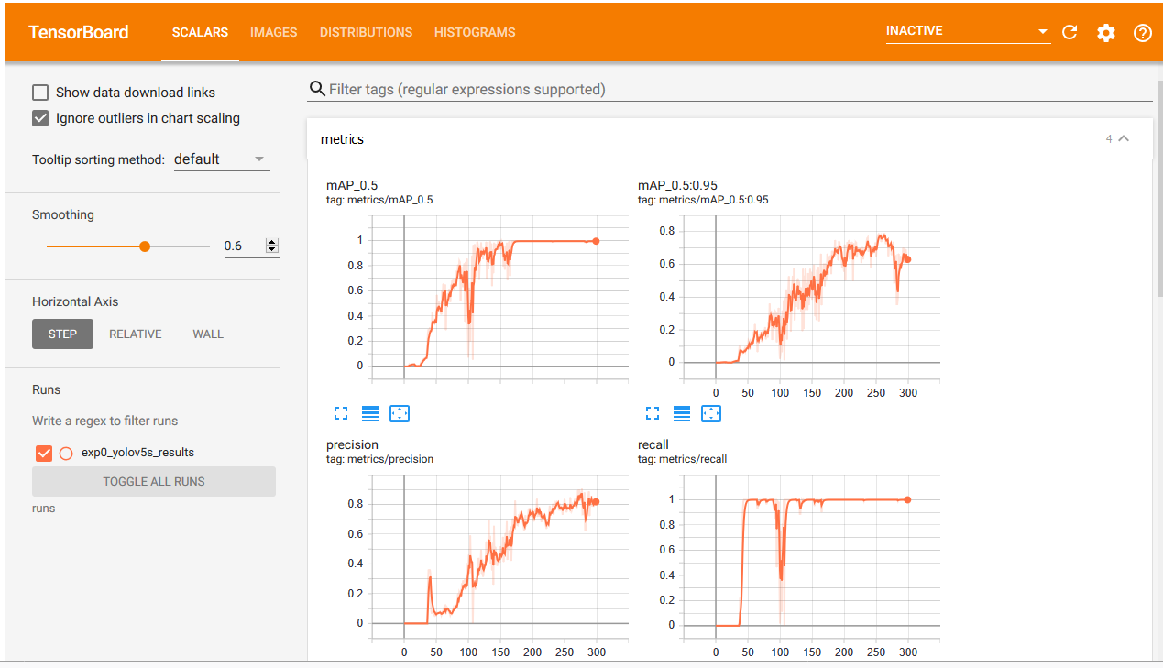

Slide 14
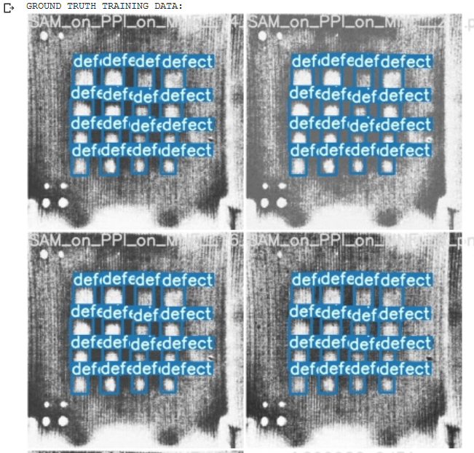

Slide 15
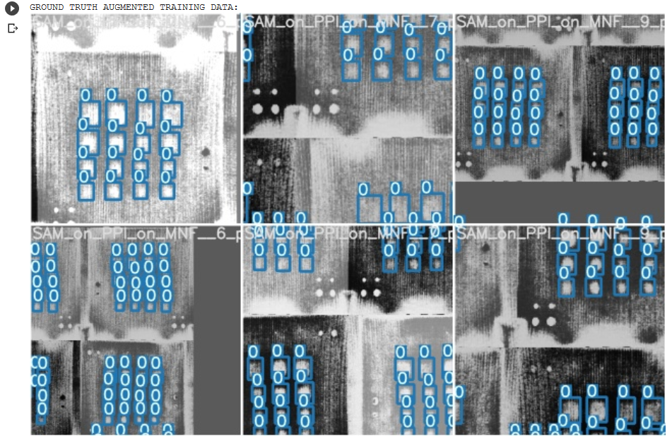

Slide 16
Test

Slide 17
